Slide 1

មជ្ឈមណ្ឌលកូរ៉េ សហ្វវែរ អេច អ ឌី
Korea Software HRD Center
Java Presentation Materials
ឣ្នកប្រឹក្សាយោបល់: បណ្ឌិត​​ គីម​ ថេខ្យុង
ឣ្នកណែនំា: លោក រ៉ាត ភារុន
លោក អាង តិចជន
លោក អាំង តឹកជុន
កញ្ញា អៀត ម៉ានិត
www.kshrd.com.kh

Slide 2
ថ្នាក់ បាត់ដំបង
ក្រុមទី ៤
ប្រធានបទ៖ Java Collections
សមាជិក
លោក ជា ភក្តី
លោក ហ៊ីម​ ខេមរា
លោក ហេង ម៉េងតាំង
កញ្ញា សំអុល​ សំអន
លោក ឈៀង សុវណ្ណវាសនា

Slide 3
មាតិកា
Collection
List
Vector
ArrayList
LinkList
Set
HashSet
TreeSet
Map
TreeMap
HashTable

Slide 4
I. Collection
Collection ជាកន្លែងផ្ទុក​ (container) នូវបណ្តុំនៃ objects ឲ្យឋិតនៅក្នុងប្រភេទនៃ
object ណាមួយជាក់លាក់ (single unit)។​ ប្រើប្រាស់វាសំរាប់៖
ធ្វើការរក្សាទុកទិន្នន័យ(store data)
ទាញយកទិន្នន័យ(retrieve)
ធ្វើប្រមាណវិធីទៅលើទិន្នន័យ(manipulate)
ស្វែងរក(search)
លុប(delete)
តំរៀបទិន្នន័យ(sort) ជាដើម។

Slide 5
I. Collection
ប្រយោជន៍នៃការប្រើប្រាស់ Collection៖
Reduces programming effort
Increase program speed and quality
Reduces effort to learn and to use new APIs
Reduces effort to design new APIs
Fosters software reuse

Slide 6
I. Collection
Java Collection Framework hierarchy. Set and List are subinterfaces of Collection,

Slide 7
I. Collection
Map តំណាងឲ្យបណ្តុំនៃ object ដែលរាល់​ object នីមួយៗវាត្រូវមានទំនាក់ទំនងជាមួយ key value។
ប្រើ​ key value ដើម្បីដាក់ object ចូលទៅក្នុង map
ហើយត្រូវប្រើ key value ដើម្បីទាញយក​ object ចេញពីក្នុង map​ វិញ

Slide 8
I. Collection

Slide 9
II. List
List ជា order collection ដែលអាចផ្ទុកនូវទិន្នន័យដូចគ្នាបាន (duplicate elements)នៅក្នុង collection។
អាចផ្ទុកនូវទិន្នន័យដូចគ្នាបាន (duplicate elements)
​ អាចឲ្យ user កំណត់កន្លែងជាក់លាក់សំរាប់ទុកទិន្នន័យ(store data)
​ អាចឲ្យ user access ធាតុតាមរយៈ index របស់វា
ស្វែងរកទិន្នន័យជាក់លាក់តាមរយៈ ​index របស់វា

Slide 10
II. List

Slide 11
II. List
concrete class ដែល implement ចេញពី list interface
List
ArrayList
Vector
LinkedList

Slide 12
II. List
ArrayList
ប្រើ dynamic array សំរាប់ធ្វើការរក្សាទុកទិន្នន័យ (storing the elements) ហើយវា extends ចេញពី abstractList class និង implements ចេញពី List interface។
អាចផ្ទុកទិន្នន័យដូចគ្នាបាន (duplicate elements)
maintains insertion order
non synchronized
allow random access
manipulation is slow because a lot of shifting needs to be occurred if any element is removed from the array list

Slide 13
II. List
ArrayList

Slide 14
II. List
ArrayList Example:
ArrayList<Integer> al = new ArrayList<Integer>();
al.add(3);
al.add(2);
al.add(1);
al.add(4);
al.add(5);
al.add(6);
al.add(6);
Iterator<Integer> iter1 = al.iterator();
while(iter1.hasNext()){
System.out.println(iter1.next());
}
Output
3
2
1
4
5
6
6

Slide 15
II. List
LinkList
ប្រើ doubly linked list សំរាប់ធ្វើការរក្សាទុកទិន្នន័យ (storing the elements) ហើយវា extends ចេញពី abstractList class និង implements ចេញពី List interface and Deque interface។
អាចផ្ទុកទិន្នន័យដូចគ្នាបាន (duplicate elements)
maintains insertion order
non synchronized
អាចប្រើជា list, stack or queue
manipulation is fast because no shifting needs to be occurred

Slide 16
II. List
LinkList

Slide 17
II. List
LinkList Example:
LinkedList<Integer> ll = new LinkedList<Integer>();
ll.add(3);
ll.add(2);
ll.add(1);
ll.add(4);
ll.add(5);
ll.add(6);
ll.add(6);
Iterator<Integer> iter2 = ll.iterator();
while(iter2.hasNext()){
System.out.println(iter2.next());
}
Ouput
3
2
1
4
5
6
6

Slide 18
II. List
LinkList VS ArrayList
ArrayList | LinkedList
1) ArrayList internally uses dynamic array to store the elements. | LinkedList internally uses doubly linked list to store the elements.
2) Manipulation with ArrayList is slow because it internally uses array. If any element is removed from the array, all the bits are shifted in memory. | Manipulation with LinkedList is faster than ArrayList because it uses doubly linked list so no bit shifting is required in memory.
3) ArrayList class can act as a list only because it implements List only. | LinkedList class can act as a list and queue both because it implements List and Deque interfaces.
4) ArrayList is better for storing and accessing data. | LinkedList is better for manipulating data.

Slide 19
II. List
Vector
ប្រើ dynamic array សំរាប់ធ្វើការរក្សាទុកទិន្នន័យ (storing the elements) ហើយវា មានមានលក្ខណៈដូច ArrayList ខុសត្រង់ថា៖
synchronised

Slide 20
II. List
Vector

Slide 21
II. List
Vector Example:
// initial size is 3, increment is 2
v= new Vector<Integer>(3,2);
System.out.println("Initial size: " + v.size());
System.out.println("Initial capacity: " + v.capacity());
v.addElement(new Integer(1));
v.addElement(new Integer(2));
v.addElement(new Integer(3));
v.addElement(new Integer(4));
System.out.println("Initial size: " + v.size());
System.out.println("Capacity after four additions: " +
v.capacity());
Enumeration<Integer> em=v.elements();
while(em.hasMoreElements()){
System.out.println(em.nextElement() + " ");
}
Output:
Initial size: 0
Initial capacity: 3
Initial size: 4
Capacity after four additions: 5
1
2
3
4

Slide 22
III. Set
ជា collection ដែលមិនអាចផ្ទុក duplicate elements. ហើយ​វា extends ចេញពី Collection interface។
​ Set មិនបង្កើត methodថ្មី ឬ constantsថ្មី
Set មិនអាចផ្ទុក duplicate elements
រាល់ concrete classes ដែលបាន implement ចេញពី Set គឺមិនអនុញ្ញាតឲ្យមាននូវduplicate elements នោះទេ។

Slide 23
III. Set
Set Interface Hierarchy

Slide 24
III. Set
“John”
“Luke”
“Paul”
“Mark”
“Fred”
“Peter”
A Set cares about uniqueness, it doesn’t allow duplicates.
HashSet
TreeSet

Slide 25
III. Set
HashSet
extends AbstractSet class and implements Set interface
no duplicate elements
contains unique elements only

Slide 26
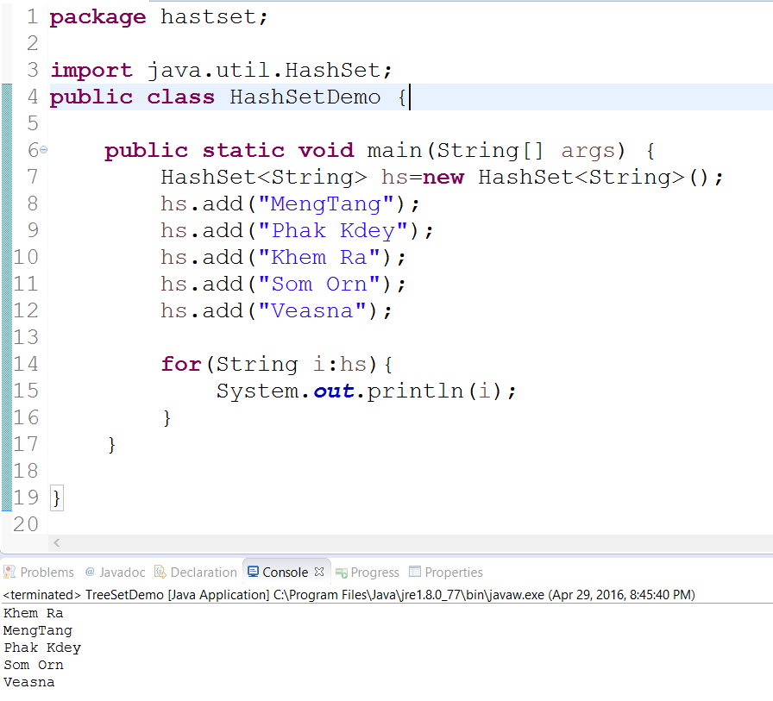
III. Set
HashSet Example:

Slide 27
III. Set
TreeSet ជា Set ដែល implement ចេញពីSet Interface ហើយប្រើ Store ជា Tree Algorithm ។
TreeSet ផ្ទុកទិន្នន័យដោយធ្វើការតំរៀបតាមលំដាប់ ។

Slide 28
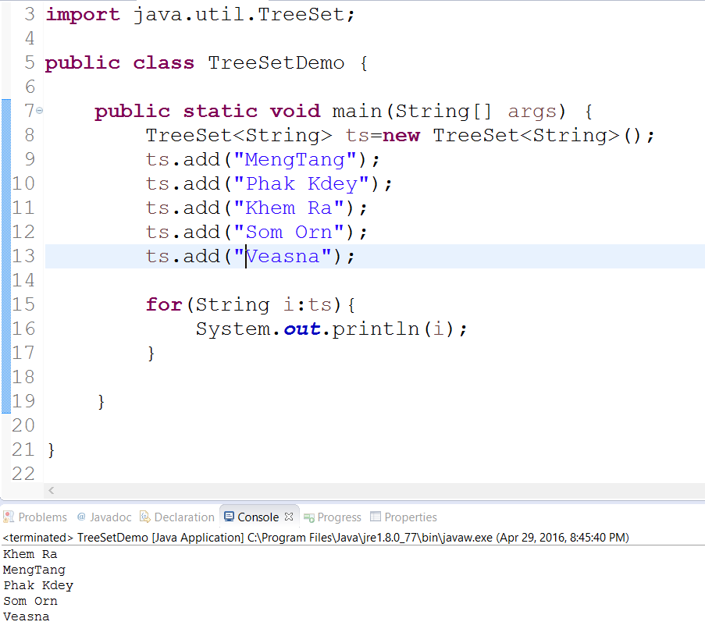
III. Set
TreeSet Example:

Slide 29
III. Set
HashSet
TreeSet
Allow null Object
Insert is much faster then TreeSet
Store the object in the random order
only add() and remove() methods exist
Uses equals() method for compare duplicate element
Not Allow Null Object
Insert is must slower then HashSet
sorted according to the natural ordering of its elements
Apart add and remove methods, also exist overloaded subSet(), headSet() and tailSet()
Uses compareTo() method for compare duplicate element

Slide 30
IV. Map
The Map interface maps keys to the elements.
Keys are like indexes.
the keys can be any objects.

Slide 31
IV. Map

Slide 32
IV. Map
Concrete Map classes
key
value
“Pl”
“Ma”
“Jn”
“ul”
“Le”
“Paul”
“Mark”
“John”
“Paul”
“Luke”
A Map cares about unique identifiers.
HashMap
Hashtable
LinkedHashMap
TreeMap

Slide 33
IV. Map
TreeMap contains values based on the key and extends AbstractMap class.
contains only unique elements
cannot have null key but can have multiple null values
maintains ascending order

Slide 34
IV. Map
TreeMap
Constructor and Description
TreeMap() Constructs a new, empty tree map, using the natural ordering of its keys.
TreeMap(Comparator<? super K> comparator) Constructs a new, empty tree map, ordered according to the given comparator.
TreeMap(Map<? extends K,? extends V> m) Constructs a new tree map containing the same mappings as the given map, ordered according to the natural ordering of its keys.
TreeMap(SortedMap<K,? extends V> m) Constructs a new tree map containing the same mappings and using the same ordering as the specified sorted map.

Slide 35
IV. Map
TreeMap Example:
Map<String,String> hm = new TreeMap<String,String>();
hm.put("Zara", "8");
hm.put("Mahnaz", "31");
hm.put("Ayan", "12");
hm.put("Daisy", "14");
System.out.println();
System.out.println("Map Elements");
for (Map.Entry<String,String> m : hm.entrySet()) {
System.out.println(m.getKey() + " " + m.getValue());
}
Output:
Map Elements
Ayan 12
Daisy 14
Mahnaz 31
Zara 8

Slide 36
IV. Map
Hashtable is an array of list and implements the Map interface.
contains only unique elements
have not have any null key or value
synchronized

Slide 37
IV. Map
Hashtable
Constructor and Description
Hashtable() Constructs a new, empty hashtable, with a default initial capacity(11) and load factor (0.75)
Hashtable(Map<? extends K,?> float loadfactor) Constructs a new hashtable with the same mappings as the given Map.
Hashtable(int initialCapacity) Constructs a new, empty hashtable with the specified initial capacity and default load factor (0.75).
Hashtable(int initialCapacity, float loadFactor) Constructs a new, empty hashtable with the specified initial capacity and the specified load factor.

Slide 38
IV. Map
Hashtable Example:
Hashtable<Integer,String> hm=new Hashtable<Integer,String>();
hm.put(100,"Amit");
hm.put(102,"Ravi");
hm.put(101,"Vijay");
hm.put(103,"Rahul");
for(Map.Entry<Integer,String> m:hm.entrySet()){
System.out.println(m.getKey()+" "+m.getValue());
}
Output:
103 Rahul
102 Ravi
101 Vijay
100 Amit

Slide 39
10. ប្រភពឯកសារ
http://www.javatpoint.com
https://docs.oracle.com
http://www.tutorialspoint.com
http://stackoverflow.com
https://docs.oracle.com/javase/tutorial/collections/interfaces/map.html
https://docs.oracle.com/javase/7/docs/api/java/util/Collection.html
http://www.tutorialspoint.com/java/java_collections.htm
http://www.javatpoint.com/collections-in-java
http://www.beingjavaguys.com/2013/03/java-collection-framework.html
Java Essential Classes & Collection book
Introduction to Programming with Java book

Slide 40

សំនួរ ចម្លើយ!

Slide 41
សូមអរគុណ!!!

